Slide 1
Ways to Improve the Quantity of Polar Orbiting Satellite Data in
Regional NWP—Preliminary Analysis of
DBNet Data and Its Characteristics
Shuang Xi
Thanks for the contribution of Shuai Yu, Liyang Zhang, Hui Liu, Gang Ma, Songlin Jia, Tianlei Yu and Minyan Wang.
National Satellite Meteorological Center(NSMC）
China Meteorological Administration(CMA)
2019.06.25 Chengdu,2019 CSPP

Slide 2
Outline
1. FY-3C VASS L1C GTS transfer
2. Mining the Usage of DBNet data in CMA
3. Near Real-time Regional Satellite Assimilation
4. L1C Data Format and Its Application in CMA

Slide 3
1.FY-3C L1C GTS transfer and latency improvement

Slide 4
GTS transfer of FY-3 VASS L1C data
FY-3 VASS L1C data are coding with BUFR mode, which is submitted by CMA to WMO in 2017 and published in WMO website. http://www.wmo.int/pages/prog/www/WMOCodes/WMO306_vI2/LatestVERSION/LatestVERSION.html
After that, FY-3C VASS data, including MWHS-II and IRAS, began to transfer by the Global Telecommunications System (GTS) to the world.
Then quick respondence from FY-3C users in Met Office said that the time latency haven’t satisfied their NWP needs yet.
So we had decided to transfer L1C data of long-arc to GTS, connected by delay receiving data and real-time receiving data, with the inspiration of the DBNet way.
Long-arc L1C including the data from delay receiving stations (such as Beijing and Kiruna also)and real-time receiving stations (such as Guangzhou, Jiamusi, Urumqi and Kiruna).

Slide 5
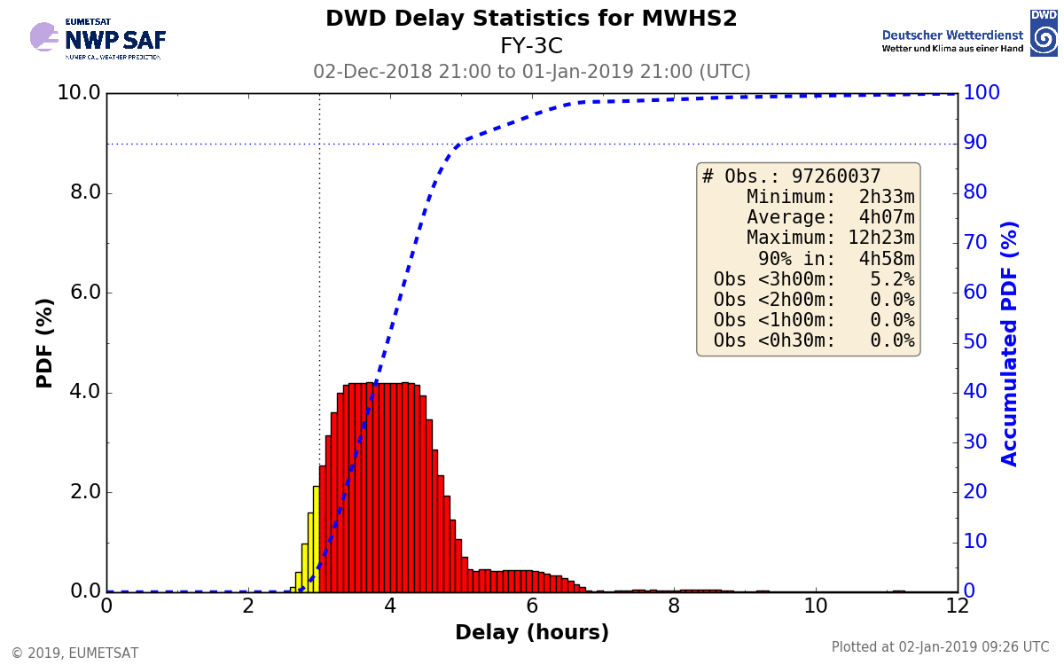
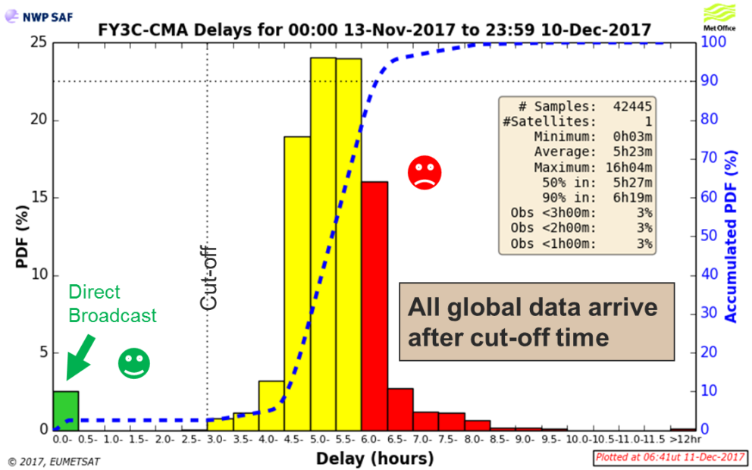
1.5hr Improvement in Latency of FY-3C by GTS
FY3C L1C (from GTS ),2018
FY3C (from EUMETcast),2017
“It is pleasing to see the timeliness improved from 4 hours (at 50% of the accumulated PDF) in the EUMETCast data to 2.5 hours in the GTS data.” （from UK Met Office，by email，early 2019）
Notes:
It is happy to get the time latency analysis from Met Office in early 2019, that FY-3 VASS L1C data from GTS meet their operational needs, having arrived 1.5 hours earlier than the original way.

Slide 6
2. Mining the Usage of DBNet in CMA

Slide 7

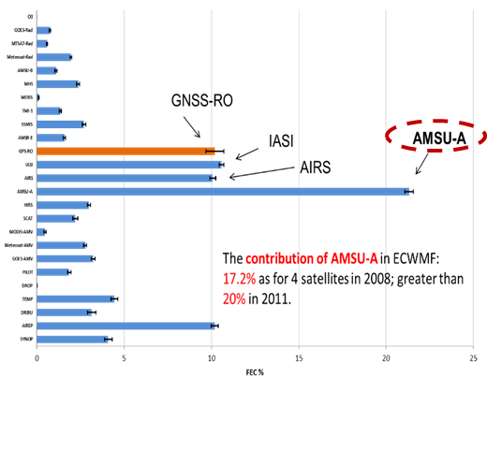
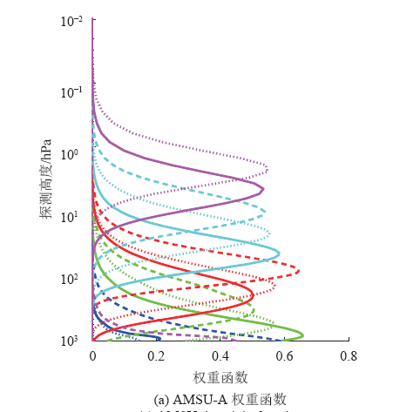
Advanced TIROS Operational Vertical Sounder (ATOVS)
Onload on NOAA series (15-19) and EUMETSAT MetOp-A/B/C。
Advanced Microwave Sounding Unit-A（AMSU-A）
Advanced Microwave Sounding Unit-B （AMSU-B）/Microwave Humidity Sounding（MHS）
High Resolution Infrared Sounder（HIRS）
2012，WMO Report
AMSU-A
Vertical sounding of atmospheric temperature
Providing the most contribution to NWP
Notes:
ATOVS是指先进的泰罗斯业务垂直探测仪，由先进微波探测器-A、先进微波探测器-B/微波湿度探测仪和高分辨率红外辐射探测仪组成，是美国NOAA极轨气象卫星和欧洲气象卫星组织的气象业务卫星MetOp-A/B/C的星载仪器。

Slide 8

Barriers of the assimilation of Polar Oribting Satellite Data in regional NWP
Data Download
Time Latency
Coverage
Data Access
Notes:
[ei]

Slide 9
Data Download
CMAcast?
Little LEO data in the corner of data list, and the original name not easy to learn for forecasters
Ftp download?
Much slower , just in orbit form,
Not steady
China Integrated Meteorological Information Service System) （CMISS)
Absorb ATOVS data from 2017,
Clear to search by many kinds of options,
Operational distribution of both orbit and arc form.

Slide 10
Urgent Needs for Time Latency
Observation cut-off time
Regional NWP
even Rapid updated cycle assimilation system (RUC)?
4DVar in Global Model.

Slide 11
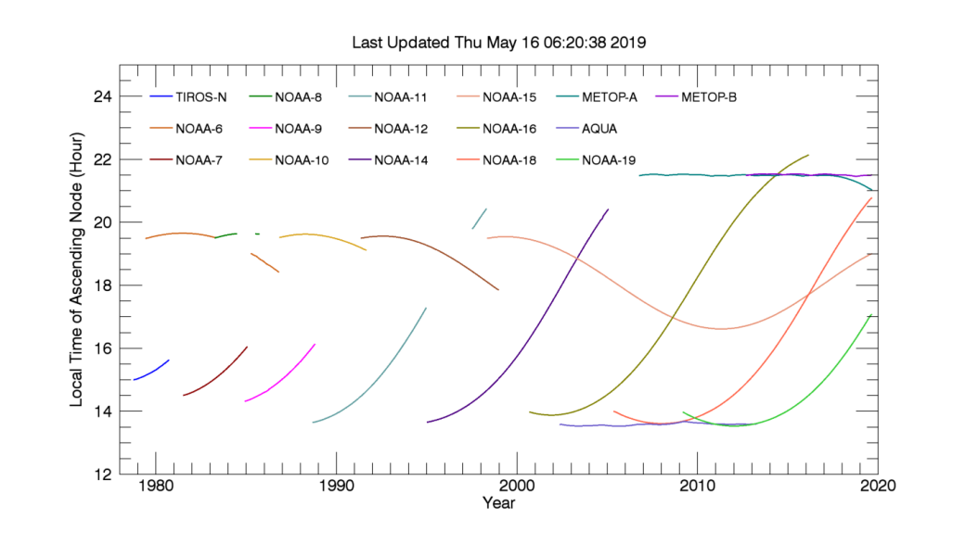
Polar Orbits
A polar-orbiting satellite is placed in a circular sun-synchronous orbit, typically at a low altitude of 700 to 800 km.
It usually takes about 100 minutes to make one trip around the earth, allowing for just over 14 orbits daily.
These satellites cross the equator at the same local solar time each day, once ascending (traveling from south to north) and once descending. Sun-synchronous orbits are often described by their equatorial crossing times (ECT). The equatorial crossing times remain nearly constant throughout the year. However, orbit degradation can cause a slow change in the value over time.
http://www.remss.com/support/crossing-times
Notes:
sun-synchronous['sɪŋkrənəs]
equatorial[,ɛkwə'tɔrɪəl]
In the figure below, we plot the local ascending node crossing time for the microwave sounding instruments that we use in our upper air temperature products. The local crossing time is important for sounding measurements because they generally need to be adjusted to account for changes in local observing time. Because the AQUA and METOP-A satellites are in controlled orbits, their crossing times do not drift substantially.

Slide 12
Coverage of LEO
Different from the fixed observations such as
surface stations, surface soundings and GEO satellite
Contents should be considered：
orbit: morning/afternoon/early moorning.
orbit drifting, ECT may change by years/months.
scan model: AMSU-A resolution:48km in nadir,30 points per scan line, 2250 in width, moving 48km every 8s along the orbit.
assimilating time windows
regional domain
Notes:
Polar Orbits
A polar-orbiting satellite is placed in a circular sun-synchronous['sɪŋkrənəs] orbit, typically at a low altitude of 700 to 800 km. It usually takes about 100 minutes to make one trip around the earth, allowing for just over 14 orbits daily. These satellites cross the equator at the same local solar time each day, once ascending (traveling from south to north) and once descending. Sun-synchronous orbits are often described by their equatorial crossing times. The equatorial crossing times remain nearly constant throughout the year. However, orbit degradation can cause a slow change in the value over time.

Slide 13
Data Access
Need Uniform Format for multiply satellites and sources.

Slide 14
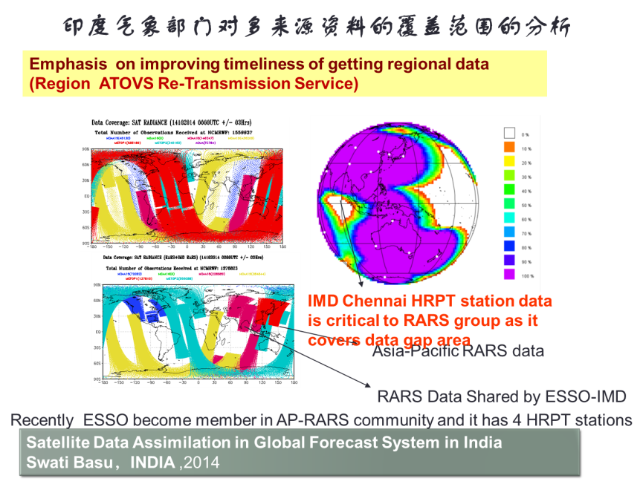
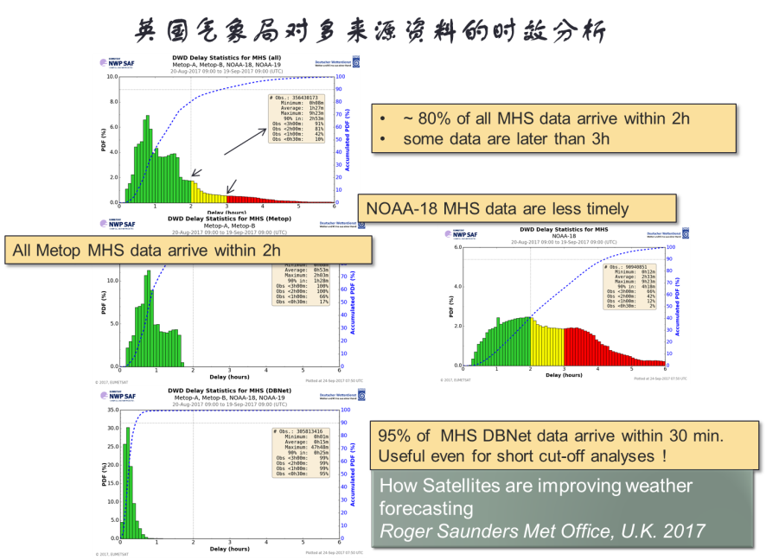
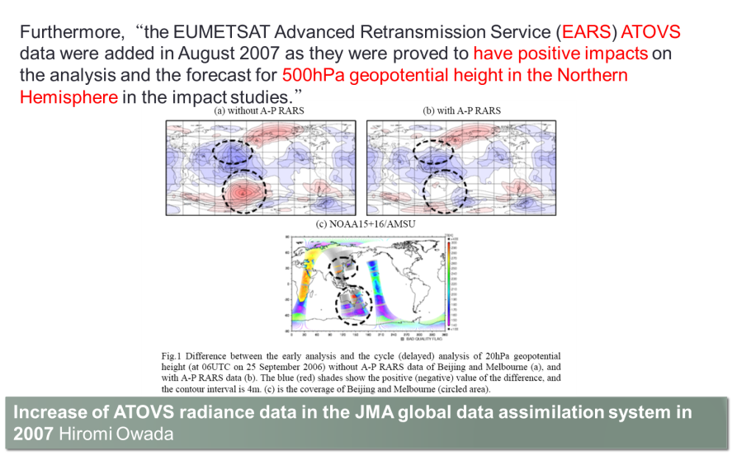
Applications of DBNet data
In Indian
In Met Office
In JMA

Slide 15
Reality of Radiance Direct Assimilation NWP in CMA
No. | Regional NWP Operation Center | System Name | Frames of Model and DA | Ver-sion | Radiance
1 | North of China | BJ-RUC | WRFv2.2， WRFDAv2.3 | 2012 | No
2 | North-east of China | North-east RUC | WRF3.1,WRFDA | 2012 | NOAA-19 AMSU
3 | East of China | East China NWP | WRF3.1,ADAS | 2012 | No
4 | East of China | GRAPES_TCM | GRAPES | 2006 | -
5 | South of China | GRAPES-CHAF | GRAPES_meso | TBD | No
6 | South of China | TRAMS-v2.0 | GRAPES | 2012 | -
7 | South of China | South China mesoscale model | GRAPES | 2012 | No
8 | Middle of China | Middle China NWP | WRF,WRFDA | 2016 | No
9 | South-west of China | South-west of China NWP | WRF3.5.1, ADAS5.3.3 | 2016 | No
10 | North-west of China | North-west China NWP | GRAPES_MESO | 2016 | TBD
11 | Urumqi | Urumqi NWP | WRF3.5.1,WRFDA3.5.1 | 2016 | No
No. | Abbreviation | Global or Regional |  | Version | DA | Radiance
1 | RGRAPES_GFS | Global | 2.1 | 2017 | 4DVar | √
2 | GRAPES_MESO | Regional | 4.2 | 2017 | 3DVar | -
3 | GRAPES_RAFS | Regional,RUC | 2.1 | 2017
4 | GRAPES_REPS | GRAPES Ensemble | TBD | 2016 | - | -
5 | GRAPES_TYM | GRAPES Typhoon | 2.1 | 2017 | - | -
PUSH DBNET to Regional NWP
National and Regional Models and Observation Assimilation in CMA
(This summary is based on from scientific articles and official documents updated by 2018.6.）
Notes:
调研

Slide 16
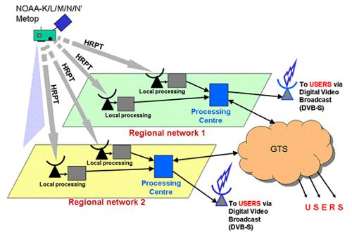
DBNet
Based on RARS
Initial goal established:
NOAA and Metop ATOVS (L1b)
from 90% of the globe
available on the GTS in 30 min
图3 Conception chart of DBNet （From WMO ）
Direct Readout Acquisition and Relay System for LEO Satellite Data.
Direct Broadcast Network (DBNet) is a set of operational arrangements for the real-time acquisition of Low Earth Orbit (LEO) satellite data through a worldwide network of local, Direct Broadcast receiving stations and the rapid delivery of these data to the global user community after pre-processing and formatting in accordance with agreed standards.
DBNet Contain:
Ground receiving stations with a unified AAPP software to process satellite data
Regional Telecommunications network and data processing center
Digital broadcasting system or GTS

Slide 17
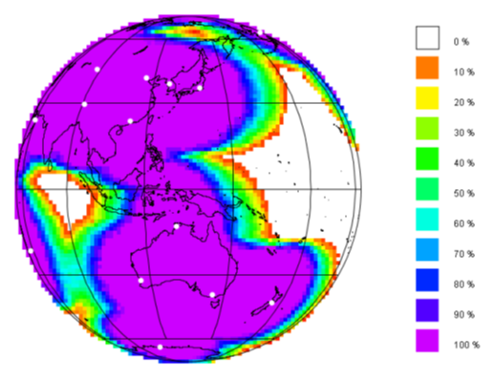
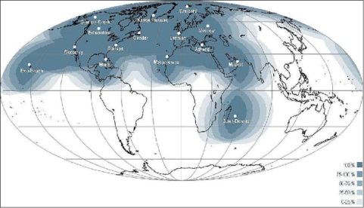
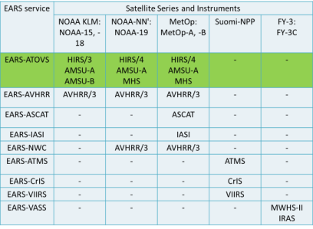
DBNet
Divided by Regions：
RARS,
EUMETcast or EARS,
South-American RARS,
…
05hr Gobal Coverage of RARS （WMO）
Global Coverage of EUMETcast
（EARS）
Including Satellites：
NOAA series ATOVS,
MetOp series ATOVS,
SNPP ,
FY-3 VASS,
……
DBNet data types in EUMETcast
Notes:
在国际上，WMO为了能够使区域站接收的极轨卫星资料快速到达区域模式用户，保证区域模式时效要求，专门成立了极轨卫星数据近实时直接广播网络DBNet（2014年前称RARS，这个 网络的构成部分包括具有统一AAPP软件处理卫星资料的地面接收站、区域通信网络、数据处理中心和数字广播系统或GTS全球通信系统,按区域可分为亚洲的转发网络RARS和欧洲气象组织的卫星资料直播系统EUMETcast等,在这个网络中站点接收的资料分包括NOAA系列卫星、METOP卫星、suomiNPP卫星 ，也包含我国FY-3资料）
在日本（2007）、印度（2014）、英国（2017）等很多国家的区域模式中均使用了区域转发资料，来提高资料覆盖率或提高资料时效。

Slide 18
DBNet Data in CMA
Table 1：ATOVS data received by CMA from multiply sources
 | Abbreviation | Types | Satellites | Transfer | Transfer Unit | Latency(hr)
1 | DBNet | RARS | NOAA-18/19 | HRPT | arc | 0.5-1
2 | DBNet | EARS | NOAA-18/19,MetOp01/02 | HRPT | arc | 0.5-1
3 | DBNet | CNB | NOAA-18(now NOAA-20) | Direct-broadcast | arc | 0.5
4 | NESDIS |  | NOAA-15/18/19 | GTS | orbit | 3-6
5 | EUMETSAT |  | NOAA-19,MetOp01/02 | GTS，Exchange | orbit | 1-1.5
ALL in Uniform L1C format by CMA Process
（as details shown in Meteorological industry standard : QX/T139-2011，QX/T29-2018）

Slide 19
L1C Format
No. | Variable Name | Data Type | Unit | Introduction
1 | Sat_id | Integer,32 bit | - | Satellite ID
2 | instrument_id | Integer,32 bit | - | Instrument ID
3 | Scan_line | Integer,32 bit | - | Number of scan line
4 | Scan_fov | Integer,32 bit | - | Scan fov
5 | obs_year | Integer,32 bit | Year
6 | obs_mon | Integer,32 bit | Month
7 | obs_day | Integer,32 bit | Day
8 | obs_hor | Integer,32 bit | hour（UTC）
9 | obs_min | Integer,32 bit | Minute
10 | obs_sec | Integer,32 bit | Second
11 | obs_lat | Integer,32 bit | *100 | Latitude
12 | obs_lon | Integer,32 bit | °*100 | Longitude
13 | surface_mark | Integer,32 bit | - | Surface mark
14 | surface_height | Integer,32 bit | meter | Altitude
15 | Local_zenith | Integer,32 bit | °*100 | Local zenith
16 | Local_azimuth | Integer,32 bit | °*100 | Local azimuth
17 | Solar_zenith | Integer,32 bit | °*100 | Solar zenith
18 | Solar_azimuth | Integer,32 bit | °*100 | Solar azimuth
19 | Sat_scalti | Integer,32 bit | km | Satellite altitude
20 | Obs_dataqual | Integer,32 bit | 无 | Data qulity flag
21 | Obs_BT（nCh） | Integer,32 bit | K*100 | Brightness temperature（nCh channels）
22 | Cld_frac | Integer,32 bit | *100 | Cloud fraction
23 | Pre_mark | Integer,32 bit | - | Precipitation mark
24 | Cld_water | Integer,32 bit | kg/m²*100 | Cloud water
25 | Pre_surface | Integer,32 bit | mm/h *100 | Surface precipitation
26 | Wind speed | Integer,32 bit | m/s *100 | Wind speed of ocean
27 | Tem_surface | Integer,32 bit | K*100 | Surface Temperature
28 | Wind_dir | Integer,32 bit | °*100 | Wind direction of ocean
29 | Emissivity | Integer,32 bit | % | Emissivity
Table 2 L1c Data Format of Radiance
from Atmospheric Vertical Soundings
Loaded in Polar Orbiting Meteorological Satellite

Slide 20
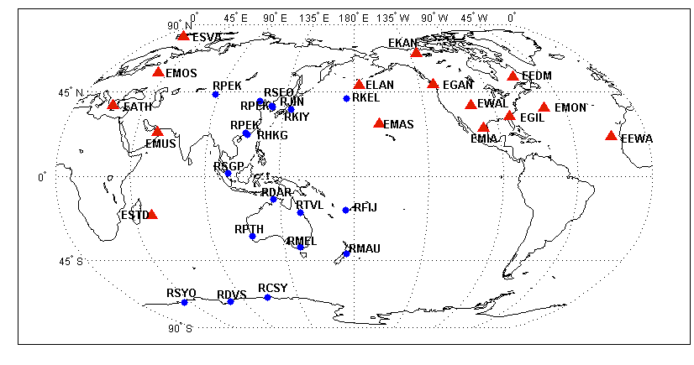
Distribution of DBNet Stations
DBNet Stations in 2014（by Hui Liu）
Red triangles :EUMETcast station，
blue dots ：RARS station.

Slide 21
Access of DBNet and other radiance Data
China Integrated Meteorological Information Service System(CIMISS)
Stored by document
Download interface: Meteorological Unified Service Interface Community（MUSIC）
Radiance data can be filed and acquired according the retrieving options as regional domain, coding center, product parameter and document format.
Notes:
数据区域范围、编报中心、产品参数和文件格式设定不同的检索参数，检索获取各种来源的卫星文件。

Slide 22
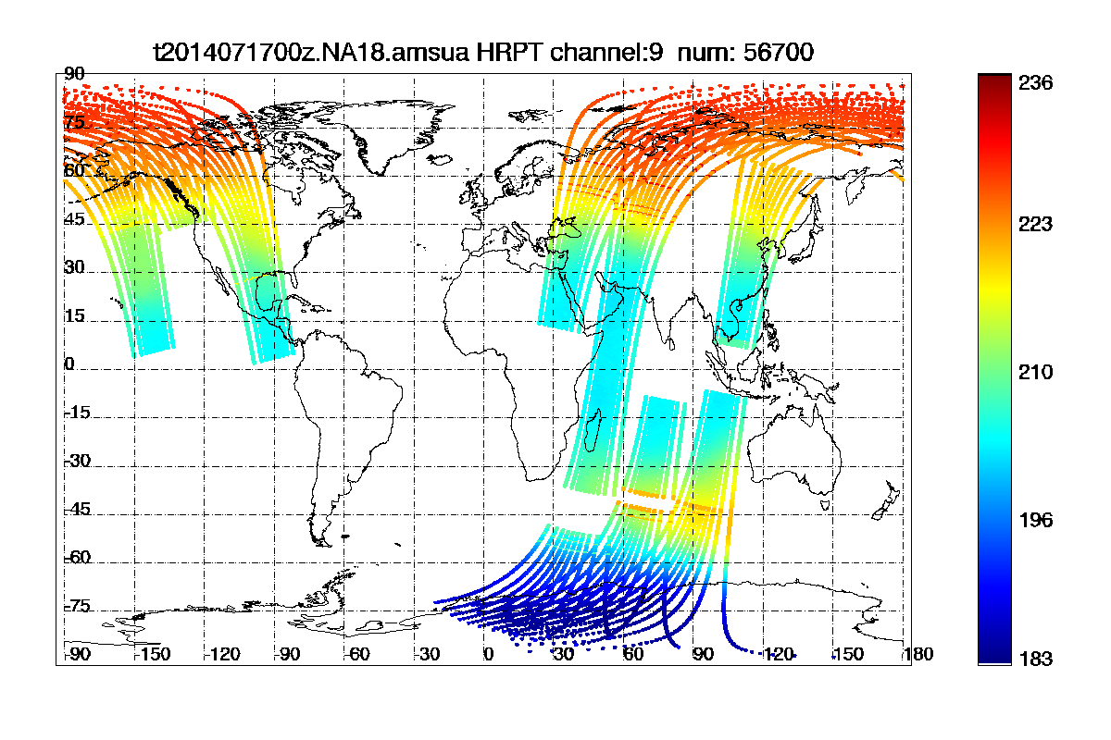
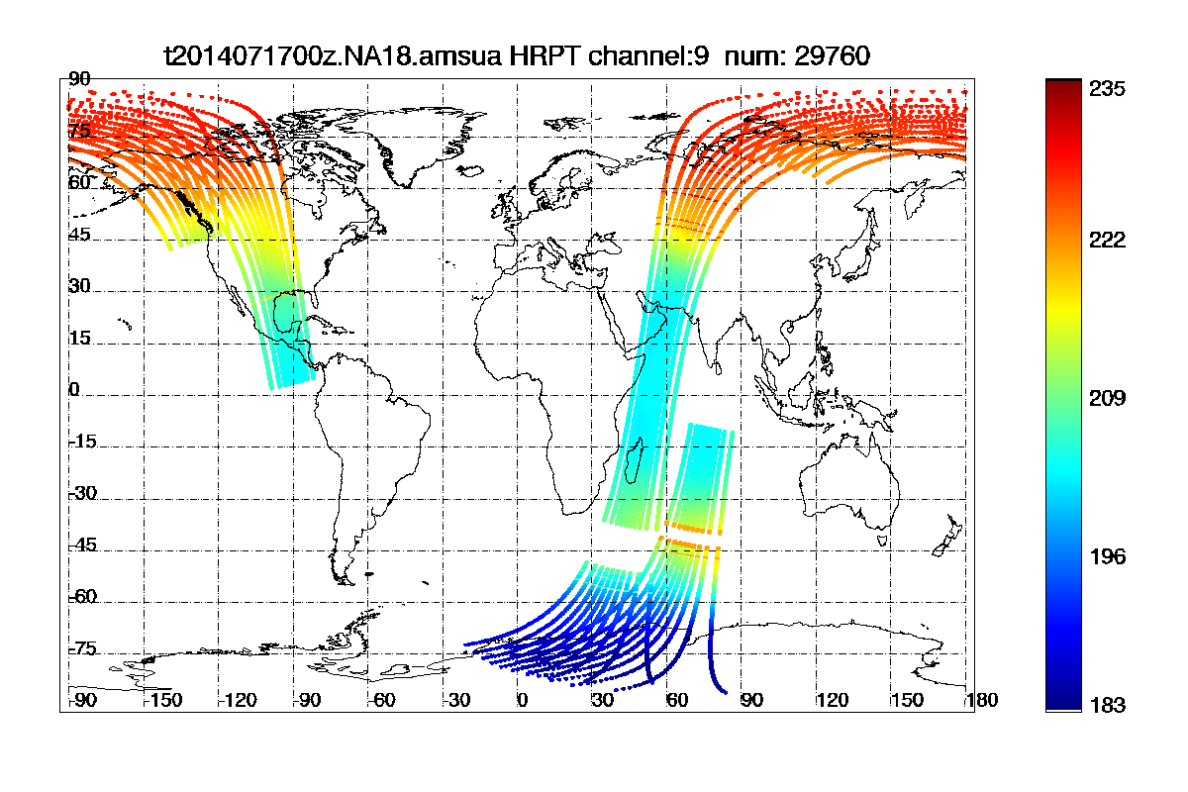
Latency and Distribution example of DBNet data
RARS： <1.5hr
From 2014 Jul. 16 to 2014 Jul. 18, latency of RARS data
(Unit: hour)
DBNet data in 3.0hr Cut-off time
NESDIS : 3-6hr
From 2014 Jul. to 2014 Dec. in 2014, latency of NESDIS data
(Unit: hour)
DBNet data in 1.5hr Cut-off time

Slide 23
Analysis scheme
Data series： 2018.06.12-2018.12.31, 203 days in total.
Regional domain：rectangular area [65°E，180°E] and [-15°S，60°N] ,
Time windows：3hr before and after the 4 times per day（00z/06z/12z/18z).
Data：AMSU-A observation from four sources and 5 satellites (NOAA-15/18/19,Metop-01/02).
Analysis Variable：Number of observation points.
Focus on: Comparation the quantity of DBNet stations and Global data under regional assimilation.
Monitoring: Multiply-source Quantity monitoring of AMSU-A

Slide 24
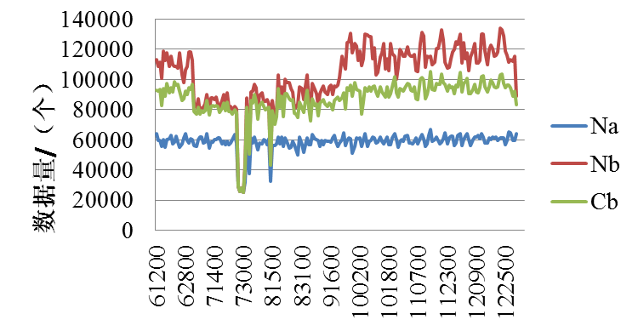
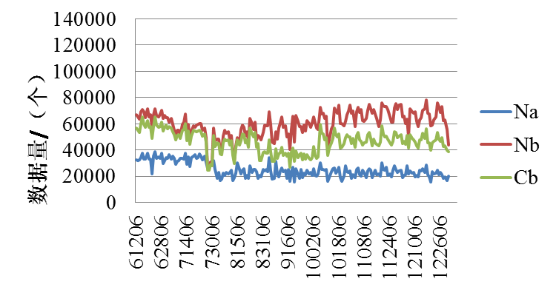
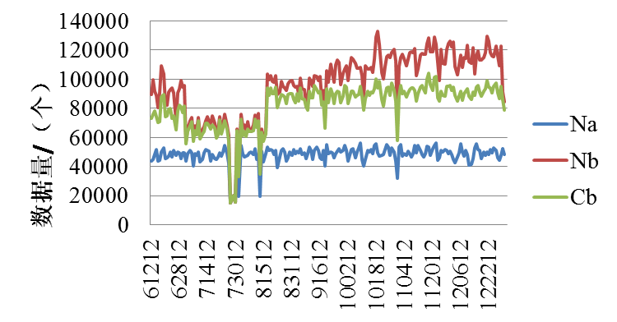
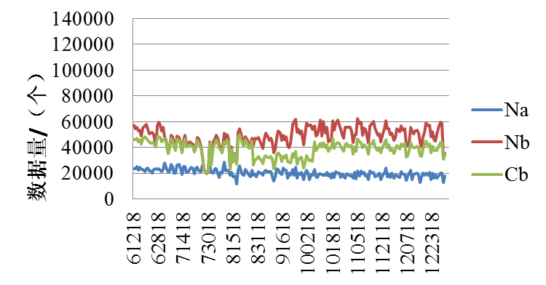
Total Number of Observation Points
UTC 06
UTC 00
UTC 12
UTC 18
Na: only global data,
Nb: glbal + DBNet，
Cb: overlap points rejected.

Slide 25
Percentage of increment by using DBNet data
Ec=(global + DBNet-overlap)/global
En =(global + DBNet)/global
En : all the percentage of increment from 2018 Jun. to Dec.
The median of En is larger than 100%,
Ec: all the percentage of increment from 2018 Jun. to Dec. ，after rejecting the overlap points.
The median of Ec is larger than 50%。

Slide 26
Satellite prior in regional total numbers
Table 3 Satellites prior in regional total numbers in a day
No | time（UTC） | Prior in total numbers
1 | 00 | NA18，MP-01，MP-02
2 | 06 | NA19
3 | 12 | MP-01，MP-02，NA18
4 | 18 | NA19
UTC 00
UTC 06
UTC 12
UTC 18
Notes:
aie

Slide 27
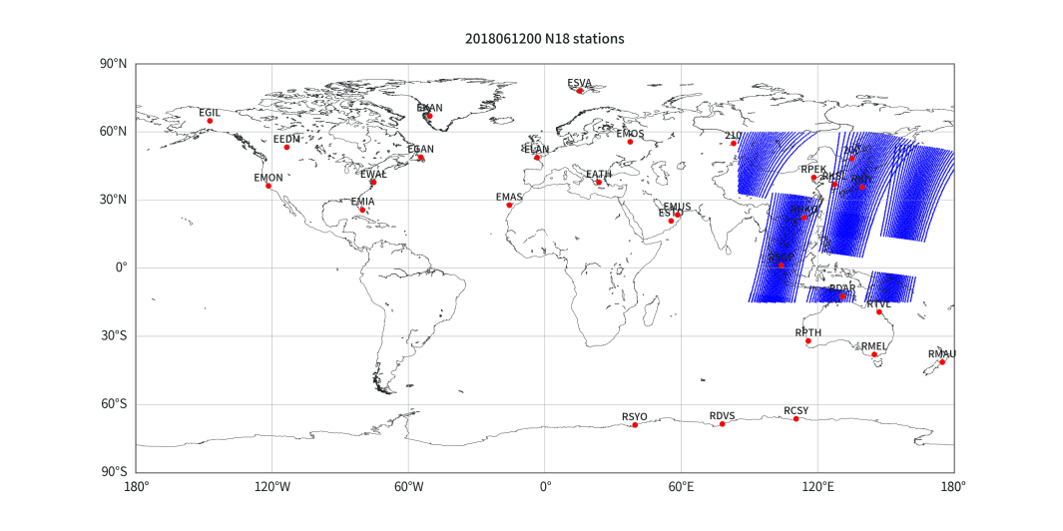
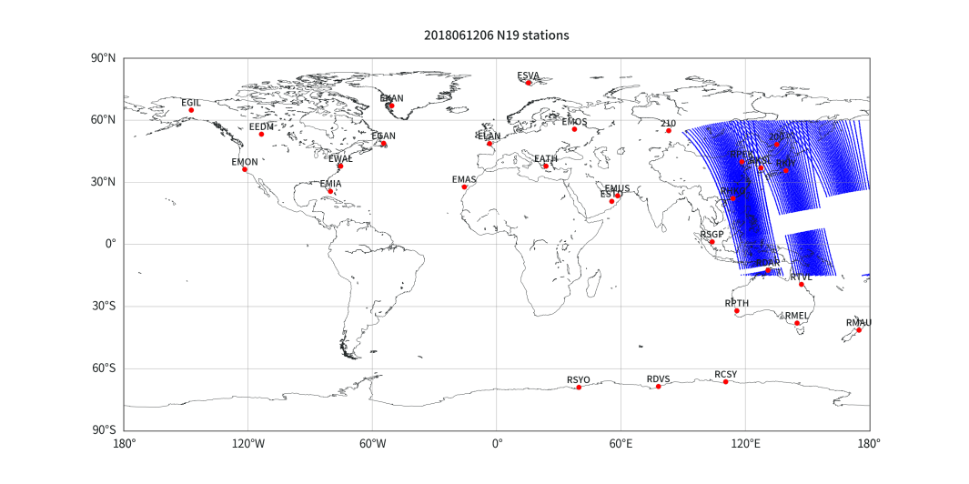
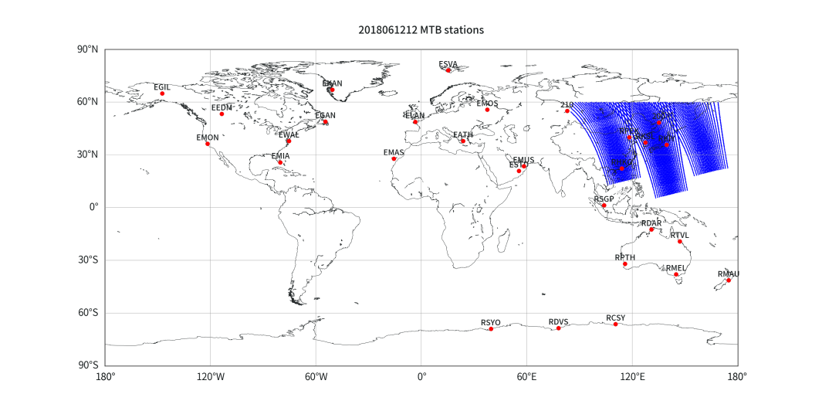
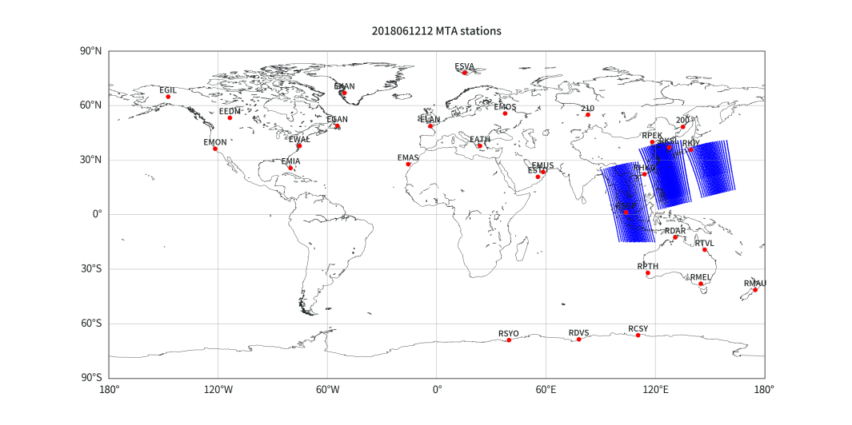
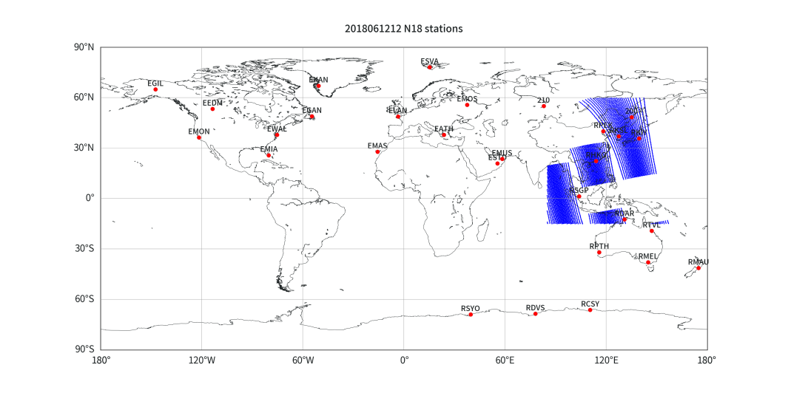
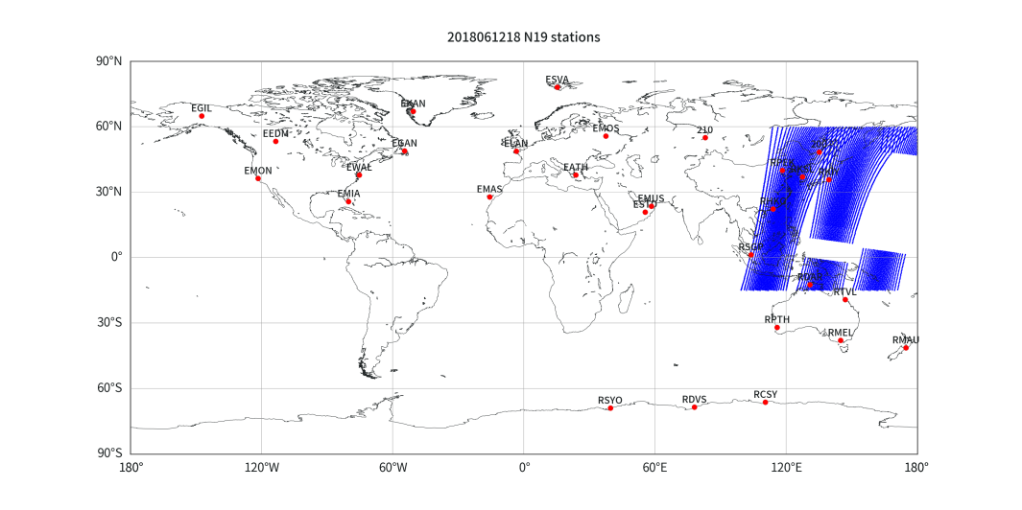
6hr Regional Distribution of Prior Satellites
NOAA-18 at UTC 00
NOAA-19 at UTC 06
Metop-01 at UTC 12
Metop-02 at UTC 12
NOAA-18 at UTC 12
NOAA-19 at UTC 18

Slide 28
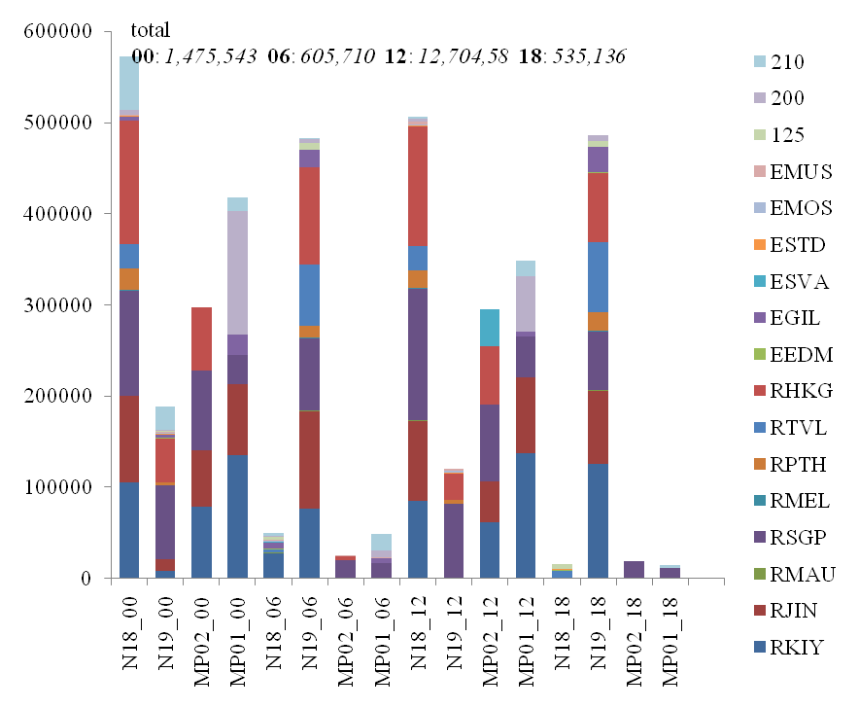
Regional contribution of different DBNet stations
Satellite and time
Four DBNet stations make main regional contribution :
Kiyose, Hong Kong, Jincheon, Singapore.
Notes:
各站点对资料量的贡献
如00时刻，NOAA18 清濑 镇川 新加坡 香港等。
06时刻，NOAA19 清濑 镇川 新加坡 香港等。
12时刻，NOAA18 清濑 镇川 新加坡 香港等。
MP02 清濑 镇川 新加坡 香港等。
MP01清濑 镇川 莫斯科等。
18时刻NOAA19清濑 镇川 新加坡 香港等。
有十六个站点对N18 N19有贡献
有6-7个站点对MP02，MP01有贡献

Slide 29
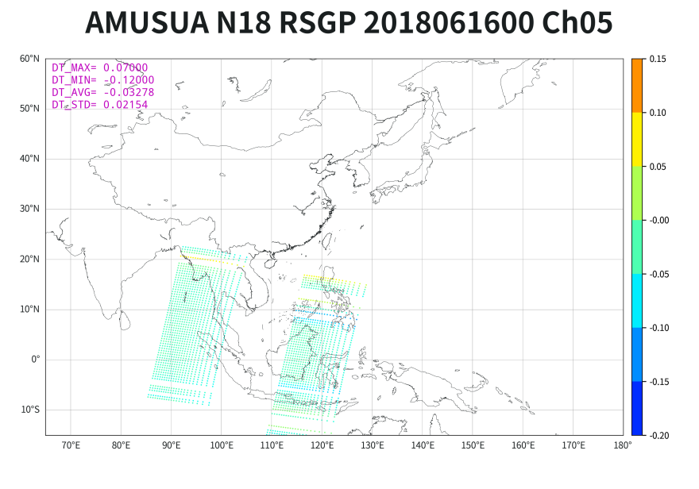
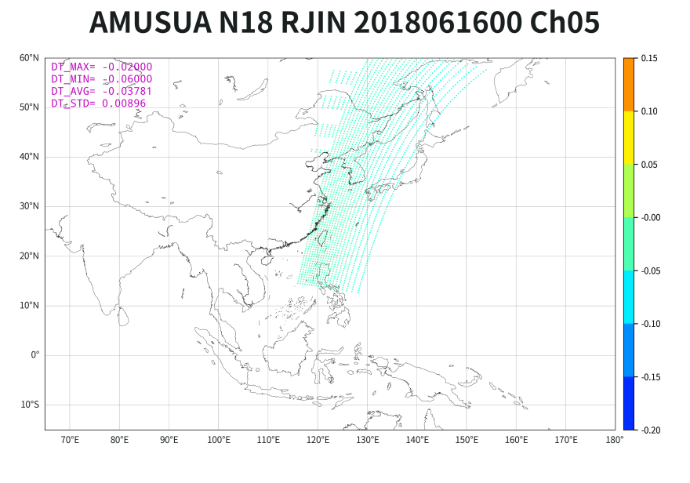
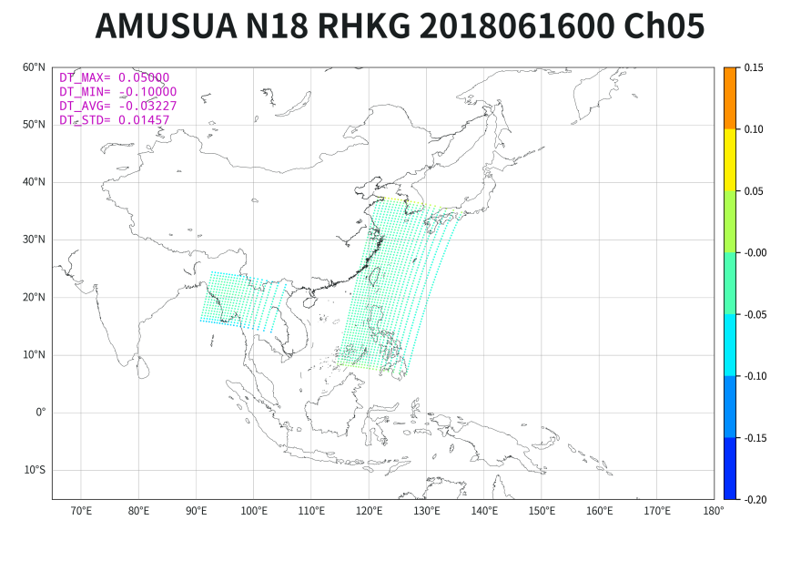
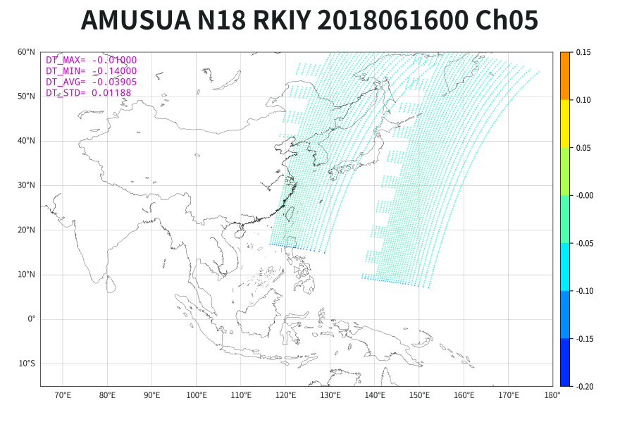
The Brightness Temperature Difference between DBNet Data and Nesdis Data
Questions：
How are difference between DBNet
And NESDIS in calibration and positioning
?
0.03-0.04K BT underestimation in average
At UTC 2018062800, AMSU-A channel 5 brightness temperature difference between DBNet and NESDIS (unit：K)

Slide 30
Summary
Multiply-source ATOVS in CMA
DBNet data have a low time latency(up to 0.5hr), recommended to be used in regional assimilation.
DBNet data could make a good complementation to global data in regional quantity.
Comparation with only using global data, the median of increment percentage of quantity is larger than 100%, and the median of increment percentage after repetition is larger than 50%.
There are some differences between DBNet and global data, in longitudes, latitudes and brightness temperature values, which implies positioning and calibration may be different between two data processing.
Future Plans
1. Long-term multi-source LEO data quality monitoring, for giving advice on selection strategies for GRAPES assimilation,
2. FY-3 satellite DBNet data (direct readout data) assimilation application.
Notes:
目前中国气象局接收的ATOVS资料有多种来源，除了常用的NESDIS资料，DBNet资料时效高（可达0.5h），建议在区域同化业务中使用。
本研究在区域模式范围和同化时间窗的条件下，分析得出：跟单一来源相比，多种来源的ATOVS微波温度计资料的观测点数总体提高百分比的中位数超过100%，去重复后总体提高百分比的中位数超过50%。
通过多种来源多颗卫星的相互搭配和融合互补，提高接收时效和扩大覆盖范围，从而提高区域同化业务上极轨气象卫星资料量。
区域接收站的资料和全球资料有一些差异，体现在经纬度和亮温，经纬度跟定位有关，亮温与定标有关，我们判断与不同卫星接收站的定标、定位有关。
计划：
1，长期的多源极轨卫星资料质量监控，为GRAPES制定同化选择策略,
2，FY-3卫星DBNet资料（直收资料）同化应用。

Slide 31
3. satellite data assimilation

Slide 32
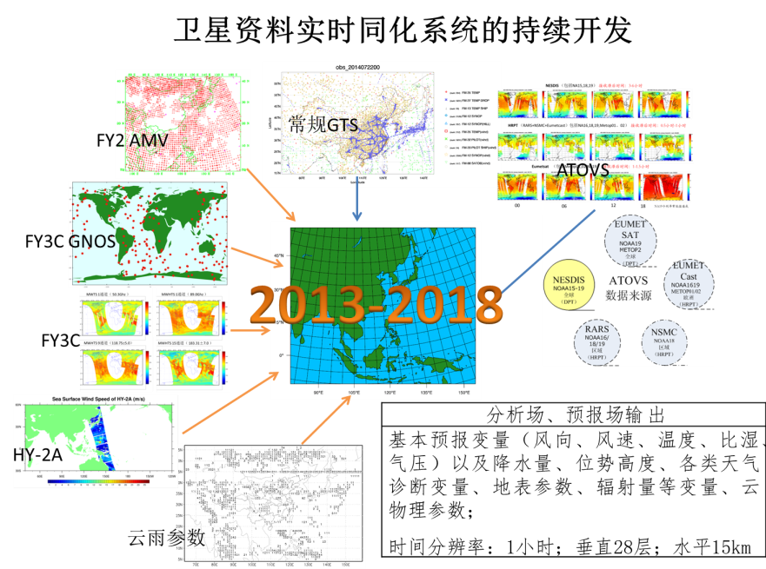
Near Real-time Regional Satellite Assimilation
Conventional Obs
Data sources
Output of Analysis and Forecast
----------------------------------------
Main forecasting variable ,such as wind direction, wind speed, temperature, moisture and pressure ,and so on.
6hr,28 vertical levels,15km horizontal resolution.
Cloud parameter

Slide 33

The Framework of Real-time Regional Satellite Assimilation

Slide 34
Steps of Real-time Operations of satellite data assimilation
Getting input observation data （radiance and conventional data) from China Integrated Meteorological Information Service System (CMISS).
Making observation preprocessing, like some transform in variable or format if they are different from the standard ones.
putting satellite observations into the DA system, which used to have the assimilation module developed for certain type of satellite data already. If not, it should be developed by yourself.
Running the DA system and 48hr regional forecasts subsequently .
Making postprocess, like track study for typhoon, visualization of forecasting filed.
Specially, we put the forecast into Meteorology Information Comprehensive Analysis Process System (MICAPS),which is familiar by the CMA forecasters.

Slide 35
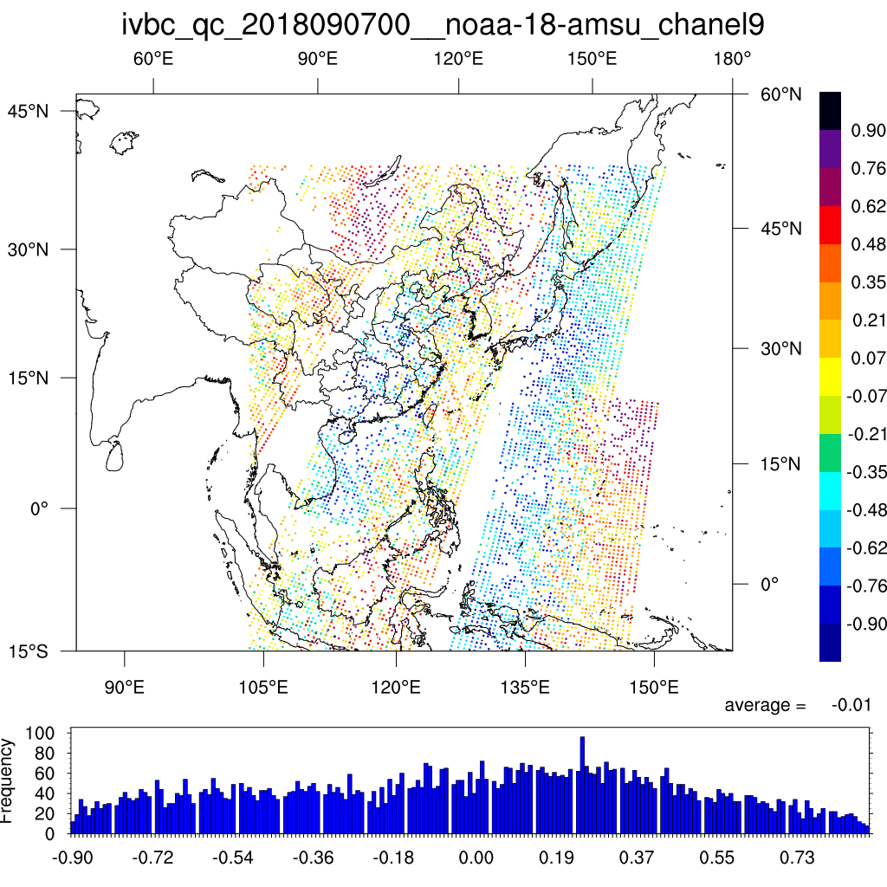
Quality Control for Multiply Polar Orbiting Satellite data
Quality control
Bias correction
Data quantity monitoring
At 00 7 September in 2018,the brightness temperature of NOAA-18 AMUS-A channel 9,after quality control and bias correction . The observation innovation is between -1.0k and 1.0k.

Slide 36
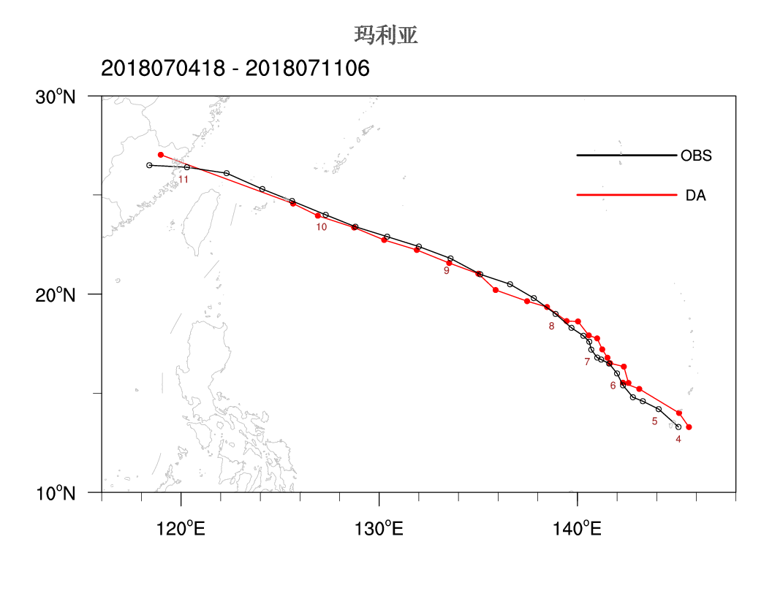
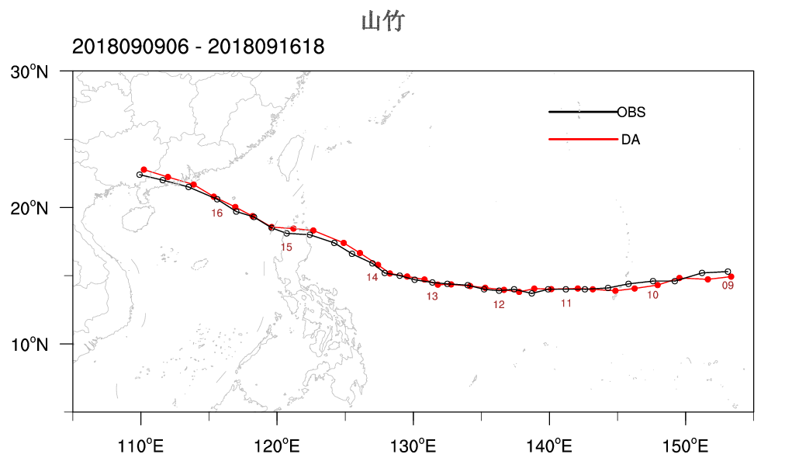
Track analysis at the assimilating time
For typhoon Maria and Mangkut in 2018
DA：Track analysis by real-time regional satellite assimilation at the analysis time,
OBS：Track analysis announced later by National Meteorological Center with lots of observations.

Slide 37
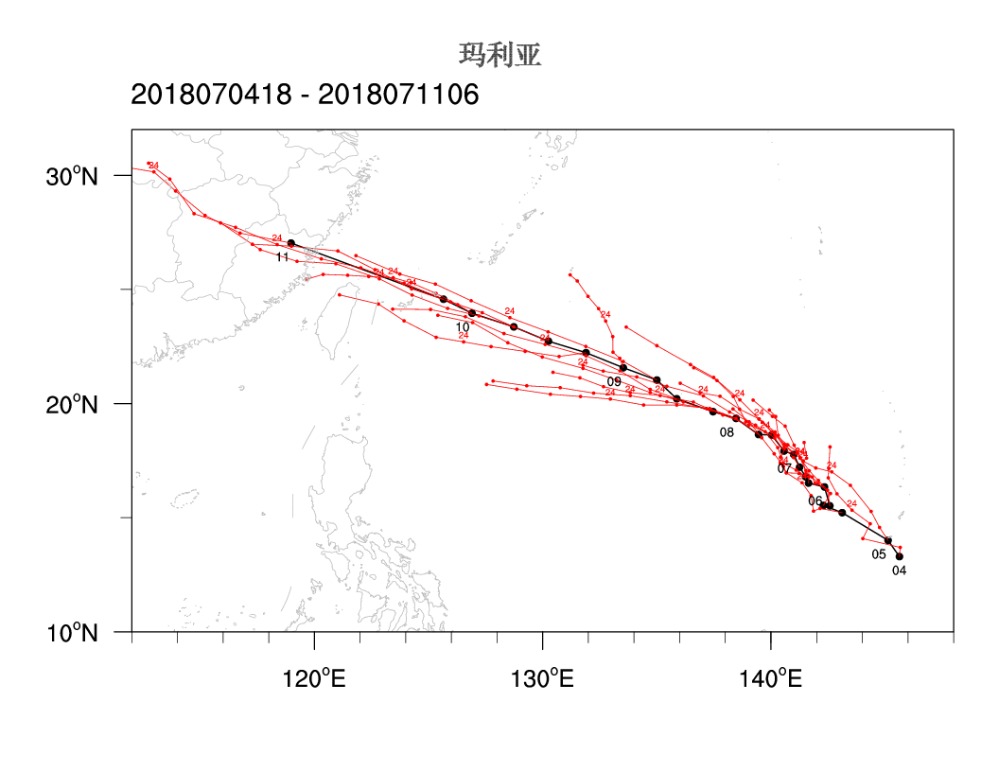
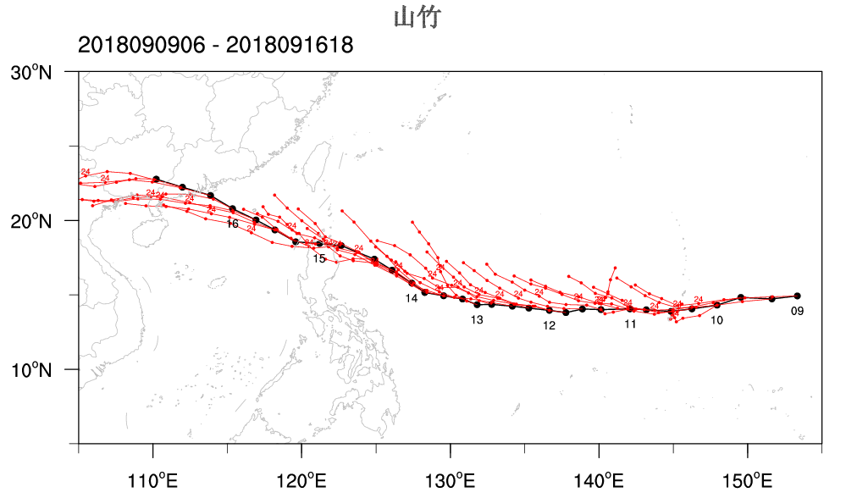
Track analysis for 48hr forecasts
For typhoon Maria and Mangkut in 2018
DA：Track analysis by real-time regional satellite assimilation and 48hr forecasts per 6hr,
OBS：Track analysis announced later by National Meteorological Center with lots of observations.

Slide 38
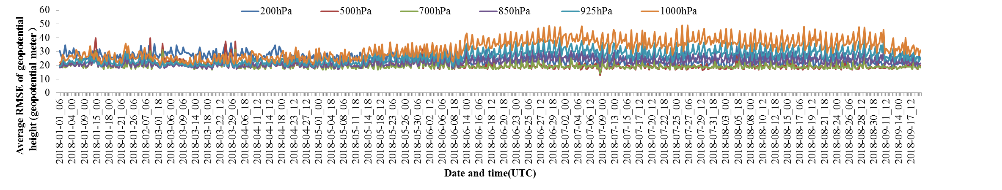
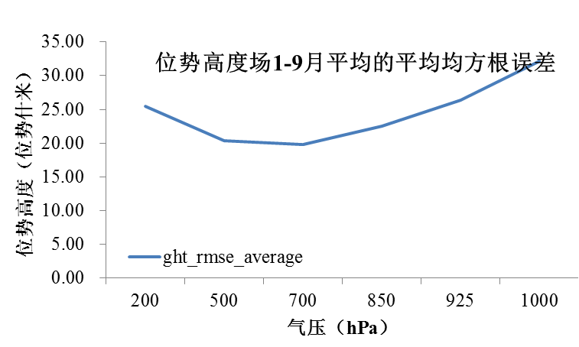
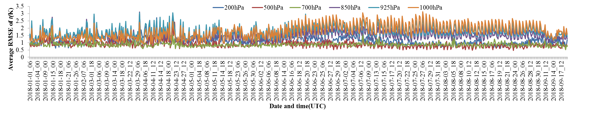
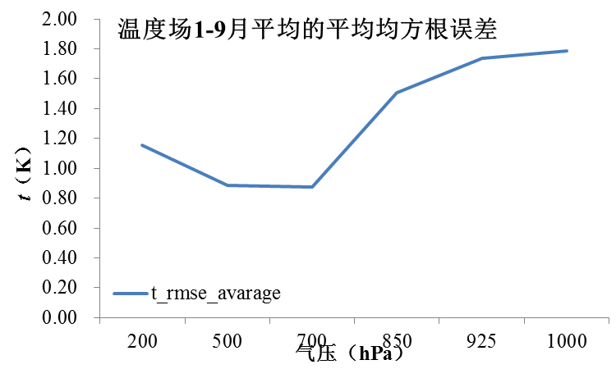
RMS with Global T639 Analysis
Geopotential height
Geopotential height
temperature
temperature
Figure 1. RMS of near real-time regional assimilation system and global T639 analysis （Geopotential height and temperature),at 6 standard pressure levels (200/500/700/850/925/1000hPa) ,from 2018 Jan. to 2018 Sep.
Figure 2. Average RMS from 2018 Jan. to 2018 Sep. at levels:
Geopotential height < 350 geopotential meters.
Temperature <2K 。

Slide 39
4. L1C Data Format and Its Application in CMA

Slide 40
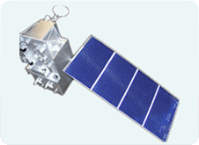
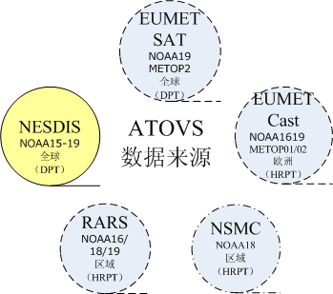
L1C DATA Transmission in CMA
FY-3 L1C data
Push to GRAPES NWP
CMAcast distribution
CIMISS
GTS global exchange（coding in BUFR format）
Resource pool
Received and Produced by NSMC
Foreign satellites L1C data
GTS,
FTP,
EUMETcast,
Ground stations
Received and processed by CMA
Push to GRAPES NWP
CMAcast distribution
CIMISS

Slide 41
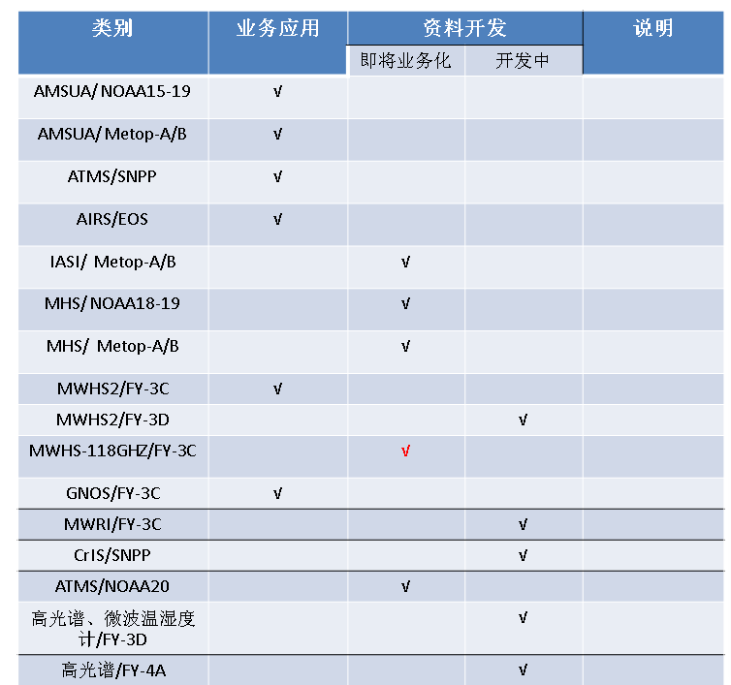
Radiance in CMA GRAPES model
All radiance data assimilated in CMA GRAPES model : L1C format.

Slide 42
L1C Data Format Standard in CMA
This industrial standard is set for Polar Orbiting Meteorological Satellite Atmosphere Vertical Sounding Data processed by CMA, in order to used in NWP data assimilation. It can suit for L1C product of NOAA-15/16/17/18/19、METOP-1，METOP-2、AQUA、S-NPP，FY-3 series VASS（IRAS（HIRAS/MWTS/MWHS) as well as the sounder onload on satellites later. And MWRI imager L1C product could also follow this standard.

Slide 43
NWP Needs for Radiance Product in Direct Assimilation
In variational theory, there is an important implicit assumption that the observation is unbiased and its probability density satisfies the nomal distribution.
Because of the error of forecasting model or radiation transfer model, O-B would be larger at mixed surface types or pixels affected by cloud and precipitation.
Data at these places should be rejected, with cloud screening, precipitation detection and mixed surface type detection.
So cloud fraction, precipitation flag are critical for NWP.
Beside, to provide satellite observation of land surface (ice,…)and sea surface (temperature and wind,..) maybe can make radiation transfer computation more accurater.
Notes:
另外，加入卫星观测的地表和海表信息（温度、风场）等信息，也有可能会提高辐射正演计算的准确度。

Slide 44
Information contents of FY-3 L1C data
Basic ontents from L1 products：
  Brightness temperature,
  FOV Observation time,
  FOV geographic imformations,
  Geometric information of observation,
  Preprocessing QC flag,
Extensible contents from L2 products：
  Cloud fraction
  Precipitation flag
  Extra contents for MWRI L1C :
  cloud water,
  Precipitation estimation,
  Land/sea surface temperature,
  wind direction /direction (over sea).

Slide 45
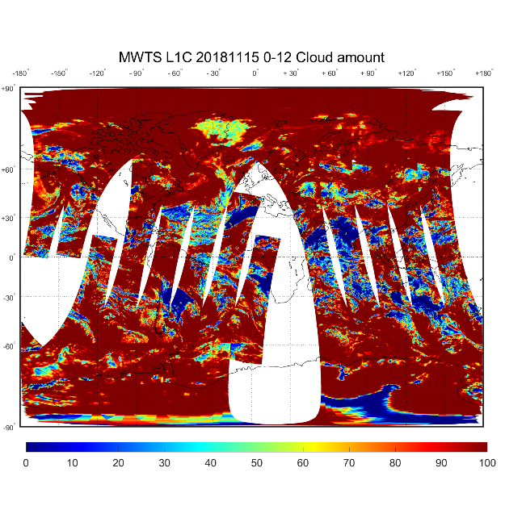
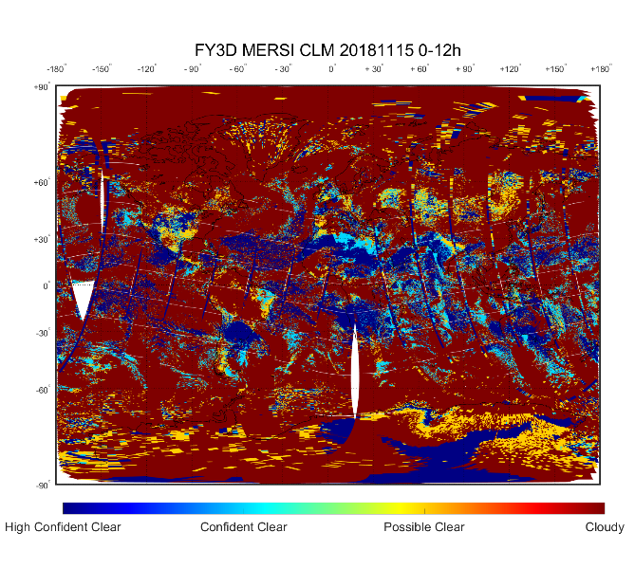
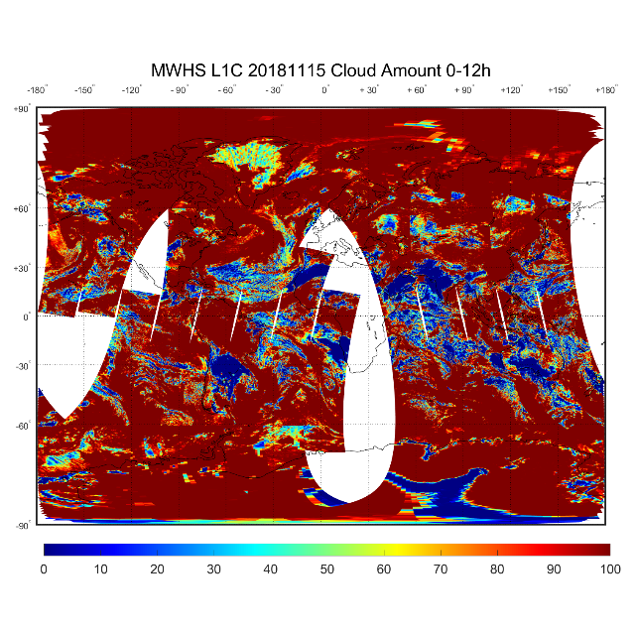
Cloud screening
Cloud mask product of Medium Resolution Spectral Imager（MERSI）
Cloud fraction of MWTS
Collocation
Cloud fraction of MWHS
From”FY-3D HIRAS/MWTSⅡ/MWHSⅡ L1c product testing report”

Slide 46
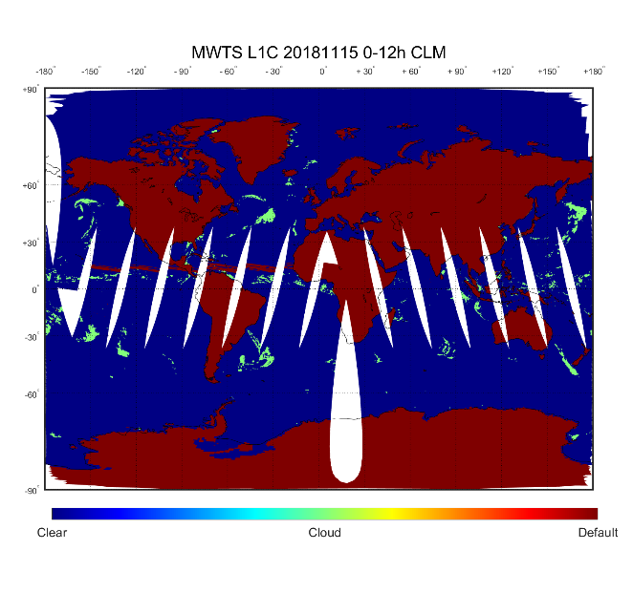
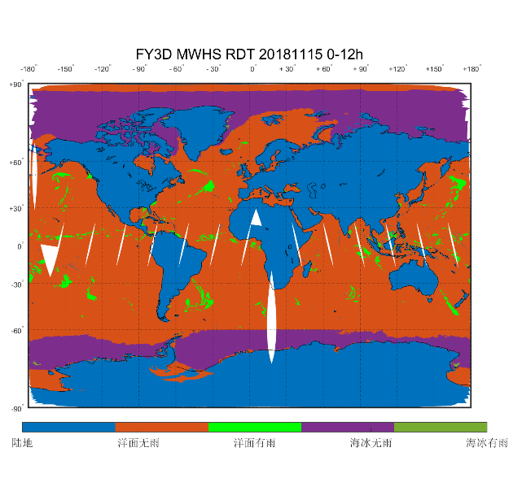
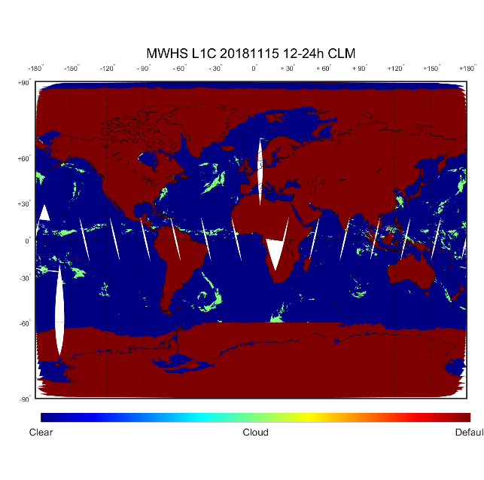
Precipitation Detection
Micro-Wave Temperature Sounder - II
Rain detection product of
Micro-Wave Humidity Sounder -II
Collocation
Micro-Wave Humidity Sounder -II
From”FY-3D HIRAS/MWTSⅡ/MWHSⅡ L1c product testing report”
Notes:
Collocation of M with N,M 同 N的 搭配。

Slide 47
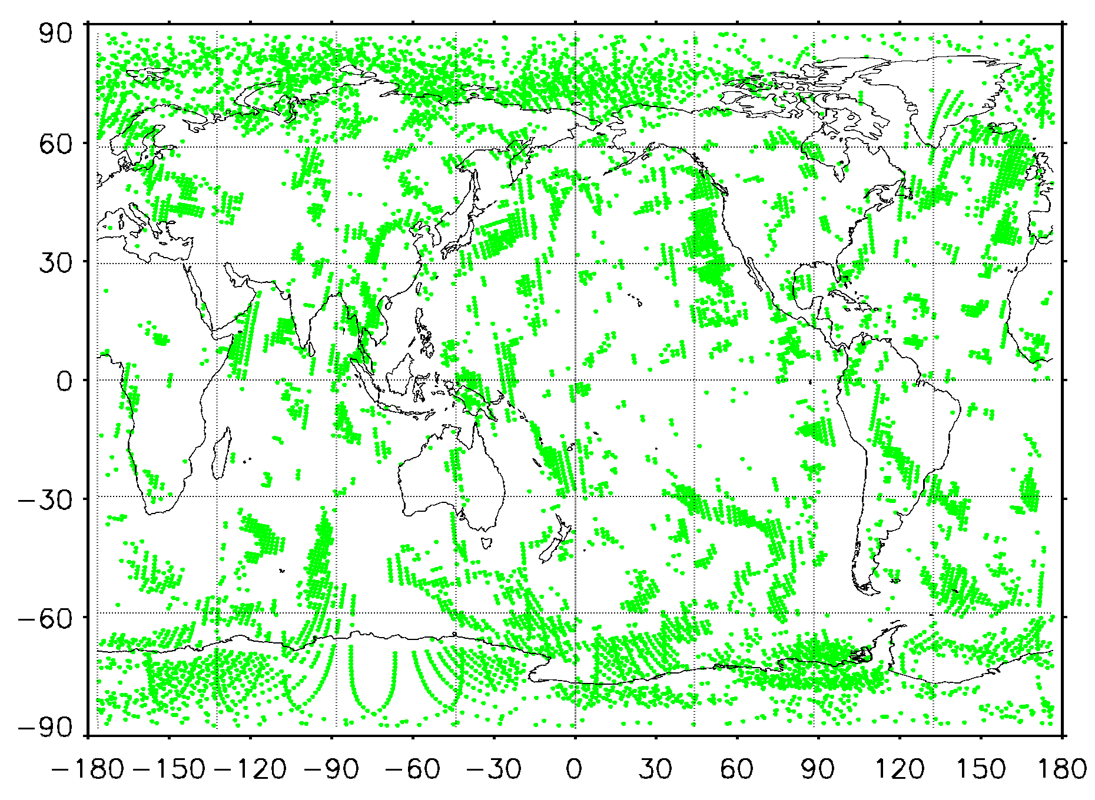



“It’s more efficient to put some critical quality control processing at data provider ,like cloud screening.” From 2012 CMA NMC Jiandong Gong’s report
Application of L1C data in GRAPES
FY-3A MWTS cloud
MSPPS CLW
0.01
0.05
MSPPS cloud water product from NESDIS
0.25
“Most of the precipitable cloud could be detected, using the cloud fraction collocation product (in FY-3A MWTS pixels)，prior to the previous O-B(>3k) method.”
0.5
1
CLW>0.25g/kg

Slide 48



Positive Impact of FY-3 L1C Product
After QC, FY-3A MWTS global data more closely resemble the National Centers for Environmental Prediction (NCEP) forecast data, the global biases and standard deviations are reduced significantly, and the frequency distribution of the differences between observations and model simulations become more Gaussian.
Juan Li，Xiao Lei Zou，2013，JOURNAL OF ATMOSPHERIC AND OCEANIC TECHNOLOGY，A Quality Control Procedure for FY-3A MWTS Measurements with Emphasis on Cloud Detection Using VIRR Cloud Fraction

Slide 49
Thank you for your attention！
Email: xishuang@cma.gov.cn

Slide 50
0.5hr Global Distribution of All Satelliltes
Assimilation of ATOVS radiances at ECMWF: third year EUMETSAT fellowship report. E. Di Tomaso, N. Bormann and S. English, August 2013, EUMETSAT/ECMWF Fellowship Programme Research Report No. 29

